Slide 1
What Hold the Future/Present? Part 1
Current World Events of Bible Prophecy

Slide 9
Who is Behind?
“There is a conspiracy of her prophets in the midst thereof, like a roaring lion ravening the prey; they have devoured souls; they have taken the treasure and precious things; they have made her many widows in the midst thereof.” Eze. 22: 25

Slide 10
Who is Behind?
“Her priests have violated my law, and have profaned mine holy things: they have put no difference between the holy and profane, neither have they shewed difference between the unclean and the clean, and have hid their eyes from my sabbaths, and I am profaned among them. ” Eze. 22: 26

Slide 11
The Change from Sabbath to Sunday
363- 364 Laodicea council
The major concerns of the Council involved constricting the conduct of church members. The Council expressed its decrees in the form of written rules or canons. Among the 59 or 60 canons decreed, several aimed at:
Limiting the privileges of neophytes,
Limiting duties of lesser clergy,
Limiting any dealings with anything heretical,
Limiting Judaizing among Christians.

Slide 12
The Change from Sabbath to Sunday
363- 364 Laodicea council
This last one, canon 29, included no more resting on the Sabbath (Saturday), but restricted Christians to honouring the Lord on Sunday even though canon 16 says the Gospels are to be read on the Sabbath. The Council of Chalcedon in 451 approved the canon of this council, making these canon ecumenical.

Slide 13
Who is Behind?
“Her princes in the midst thereof are like wolves ravening the prey, to shed blood, and to destroy souls, to get dishonest gain.” Eze. 22: 27

Slide 14
Special Date 1888
Sunday Law about to Pass Congress in US

Slide 19
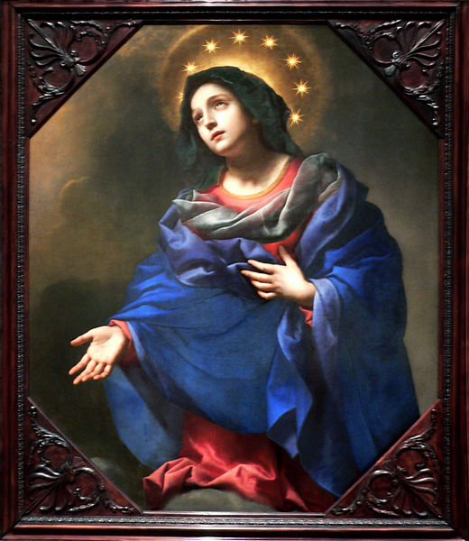
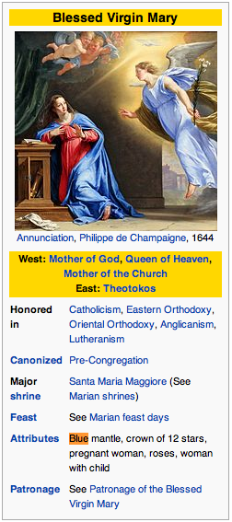

Slide 20
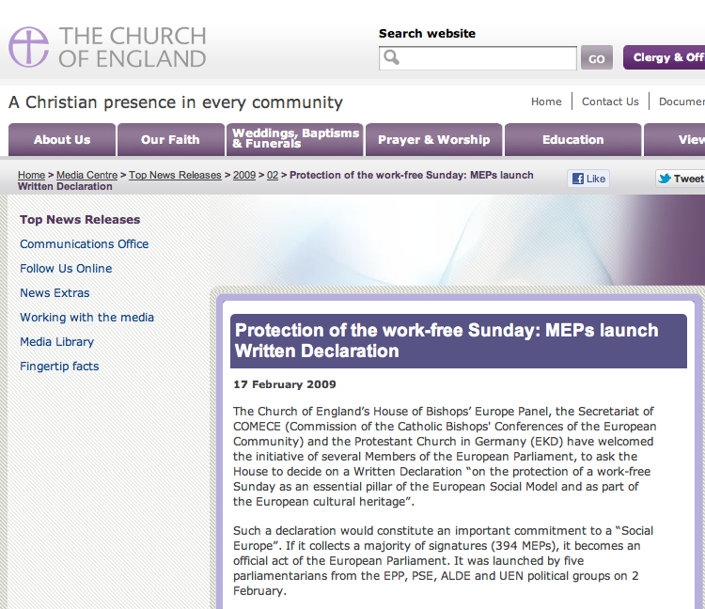
Notes:
http://www.churchofengland.org/media-centre/news/2009/02/pr1909.aspx

Slide 21
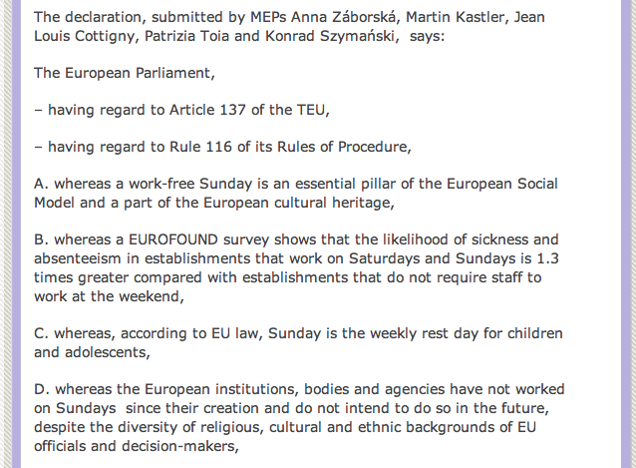

Slide 22
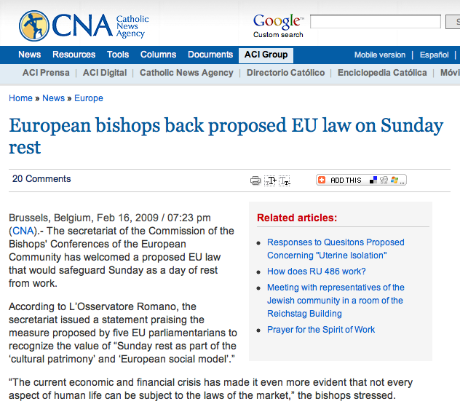
Notes:
http://www.catholicnewsagency.com/news/european_bishops_back_proposed_eu_law_on_sunday_rest/

Slide 23
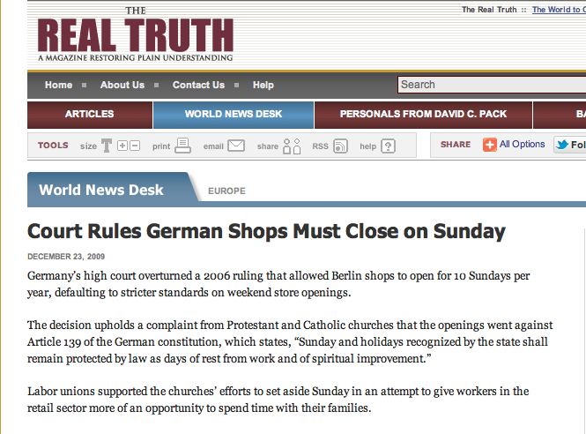
Notes:
http://www.realtruth.org/news/091221-001-europe.html

Slide 24
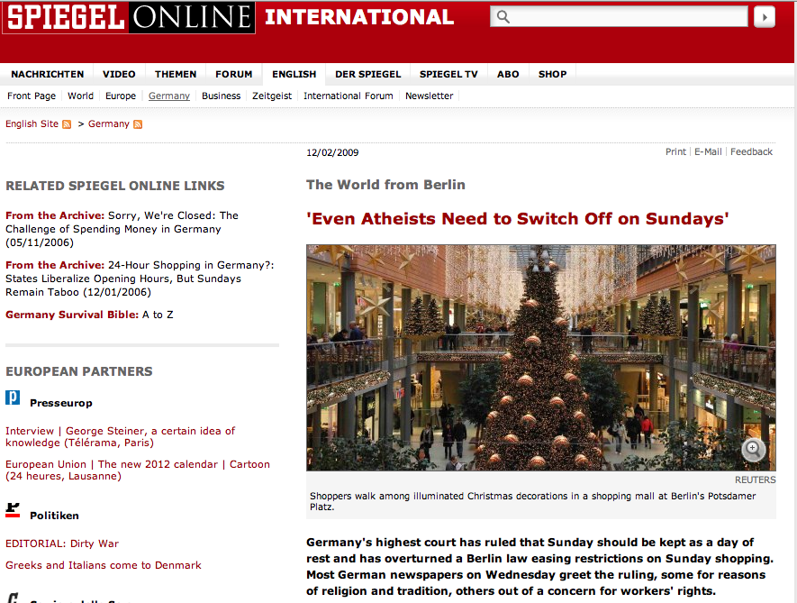
Notes:
http://www.spiegel.de/international/germany/0,1518,664754,00.html

Slide 25
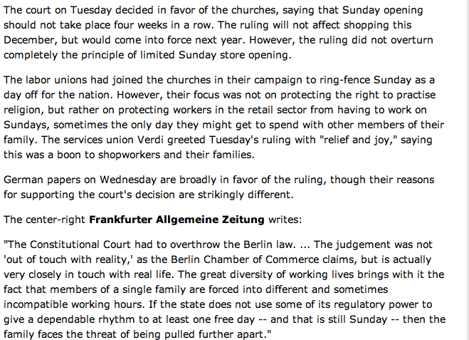

Slide 26
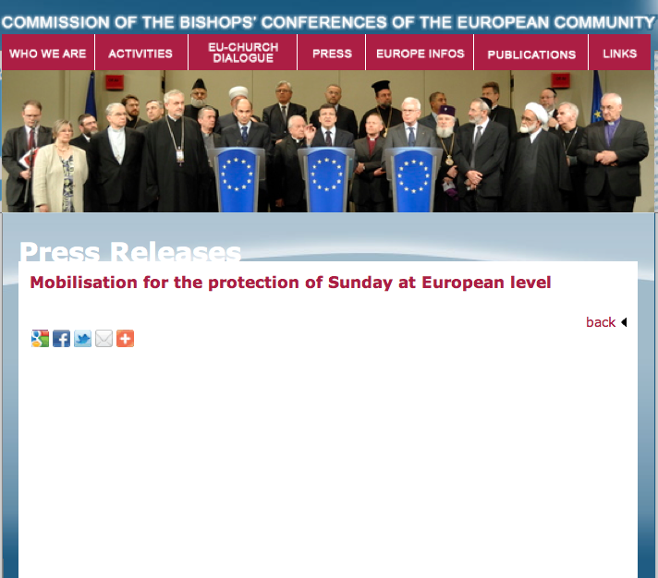
A Conference to relaunch the debate on Sunday protection at European level will be held on 24 March in the European Parliament in Brussels. It is organised by the MEPs Thomas Mann (EPP, Germany) and Patrizia Toia (S&D, Italy) together with the Konrad-Adenauer Foundation. Several European trade unions, civil society organisations and Churches support the conference. László Andor, the new EU Commissioner for Employment and Social Affairs will take the floor, as well as numerous experts and MEPs.
Notes:
http://amazingdiscoveries.org/AD-Content-Library-NewsUpdates-WorldNews-MobilisationSundayEuropean

Slide 29
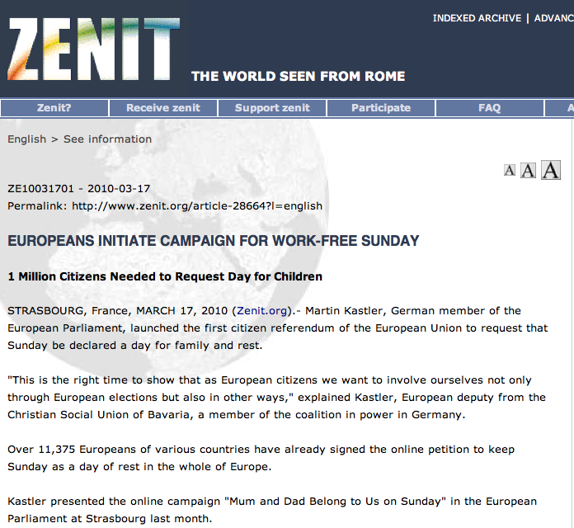
Notes:
http://www.zenit.org/article-28664?l=english

Slide 30
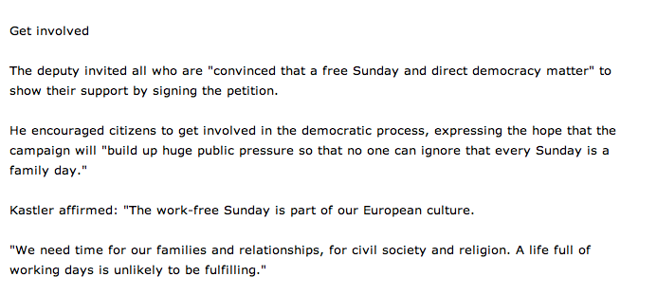

Slide 31
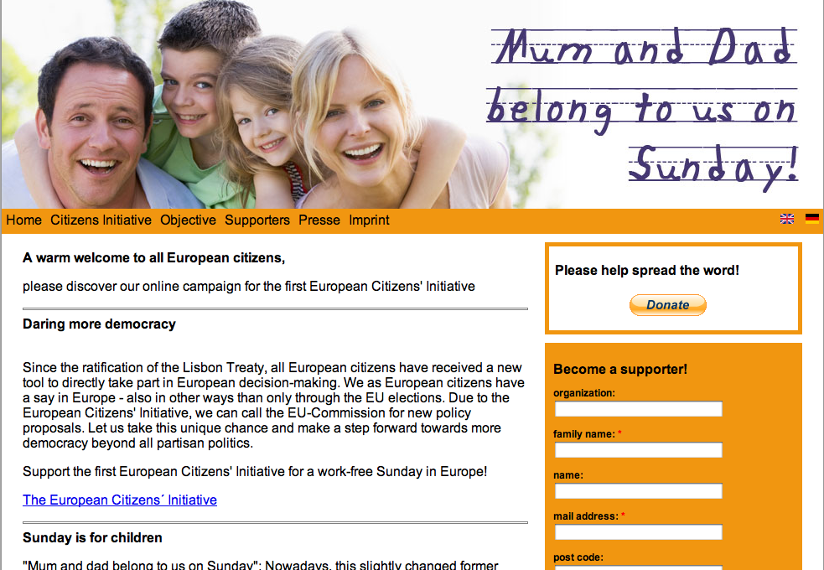

Slide 32
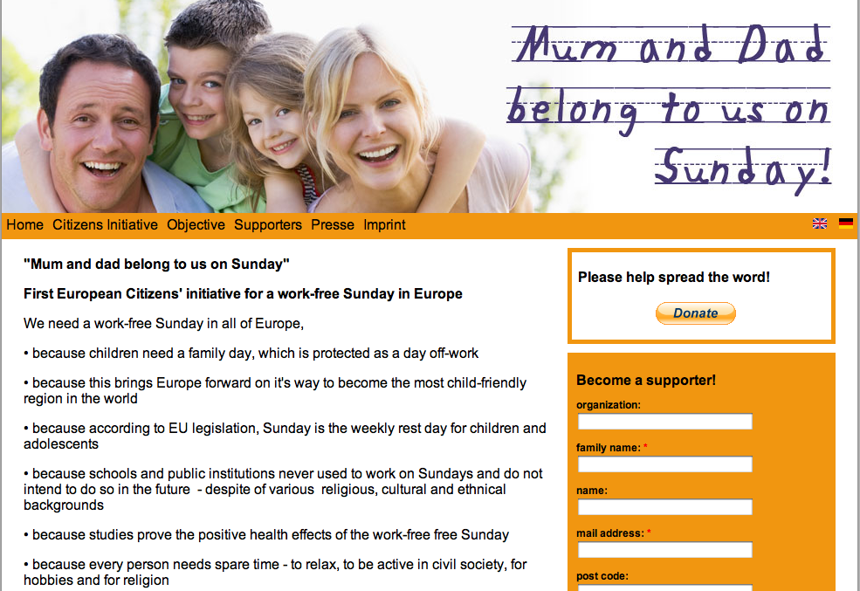

Slide 33
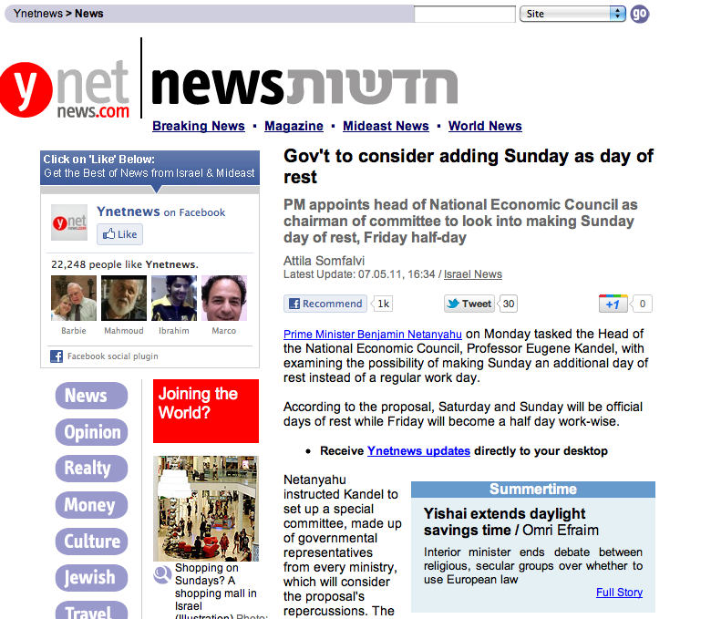
Notes:
http://www.ynetnews.com/articles/0,7340,L-4091159,00.html

Slide 34
Notes:
http://www.europeansundayalliance.eu/site/home

Slide 35
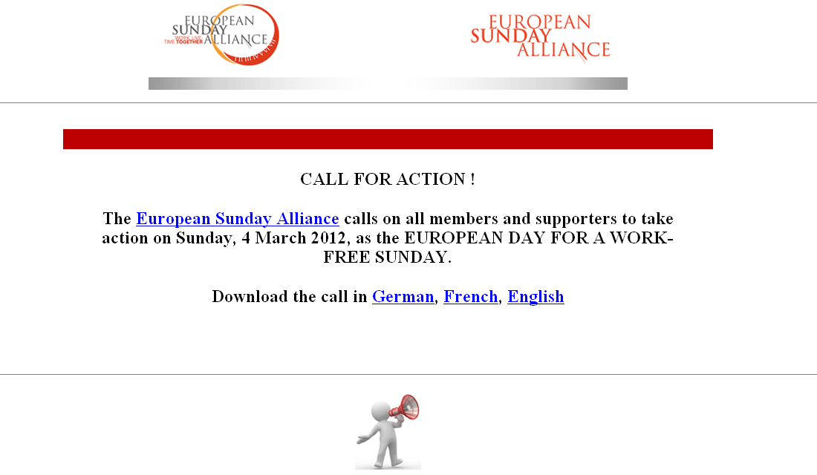

Slide 36
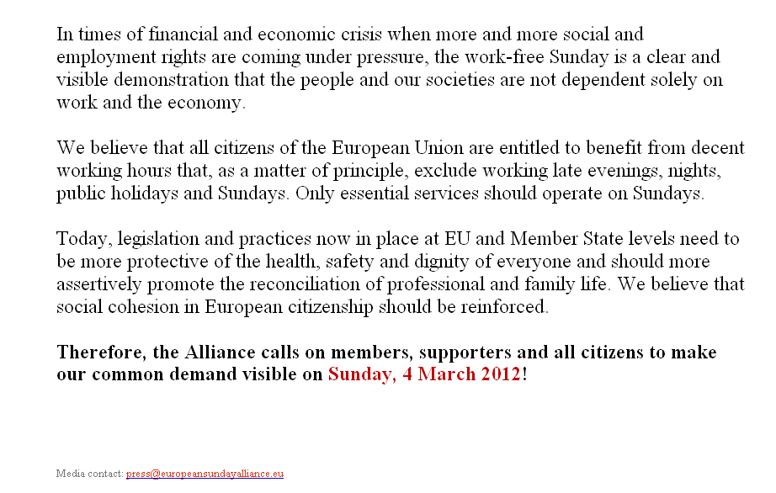

Slide 37
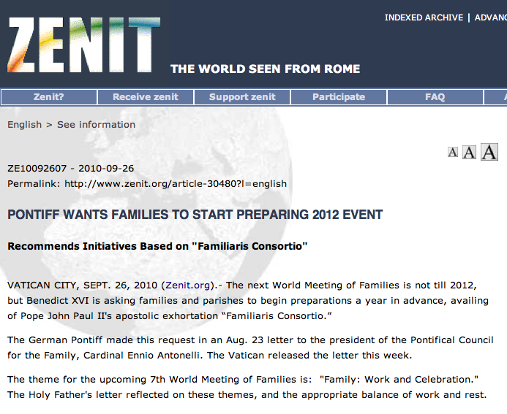

Slide 38
Pope’s letter on the 7th World Family Meeting , 2012

Slide 39
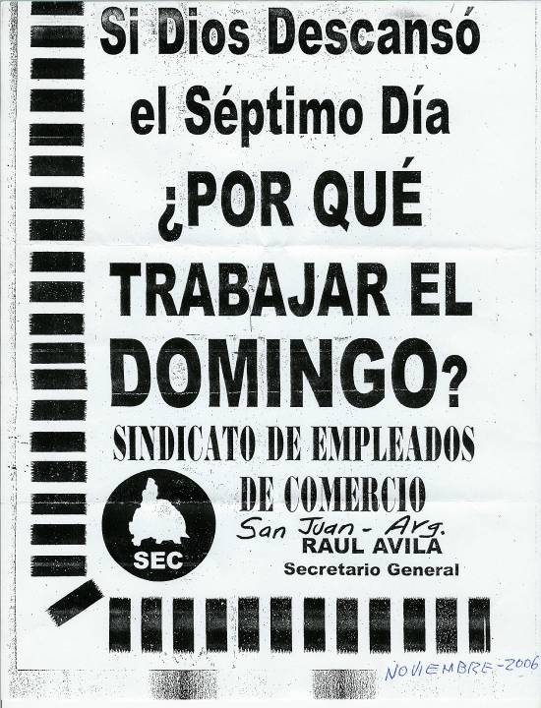

Slide 40
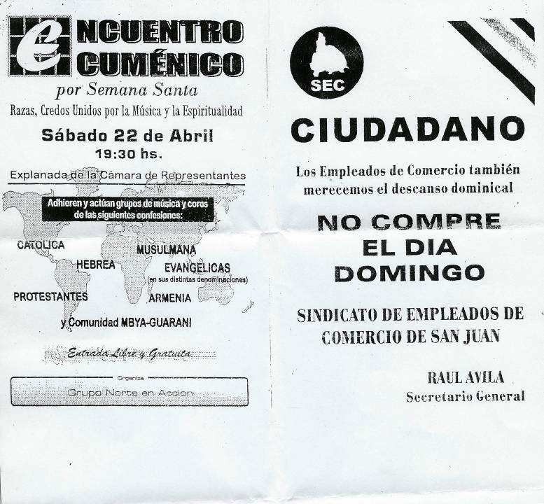

Slide 42
The Law of God Made Void
Notes:
Not only a Sunday Law, but Anti Sabbath Keeping

Slide 43
Where will the Laws will come from?
To secure popularity and patronage, legislators will yield to the demand for Sunday laws. But those who fear God, cannot accept an institution that violates a precept of the Decalogue. On this battlefield will be fought the last great conflict in the controversy between truth and error. And we are not left in doubt as to the issue. Today, as in the days of Esther and Mordecai, the Lord will vindicate His truth and His people. {PK 605.3}

Slide 47
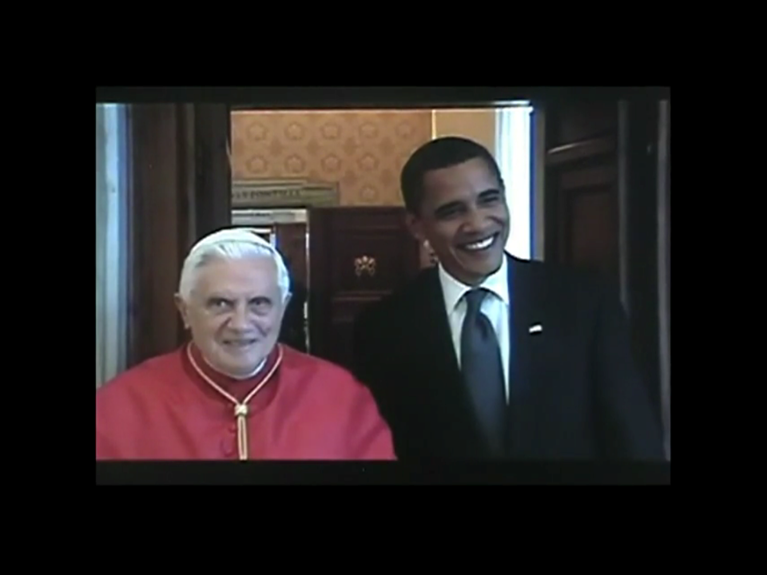
Church & State

Slide 48
Notes:
http://religion.blogs.cnn.com/2012/01/01/12-faith-based-predictions-for-2012/

Slide 49
Notes:
http://backtochurch.com/

Slide 50
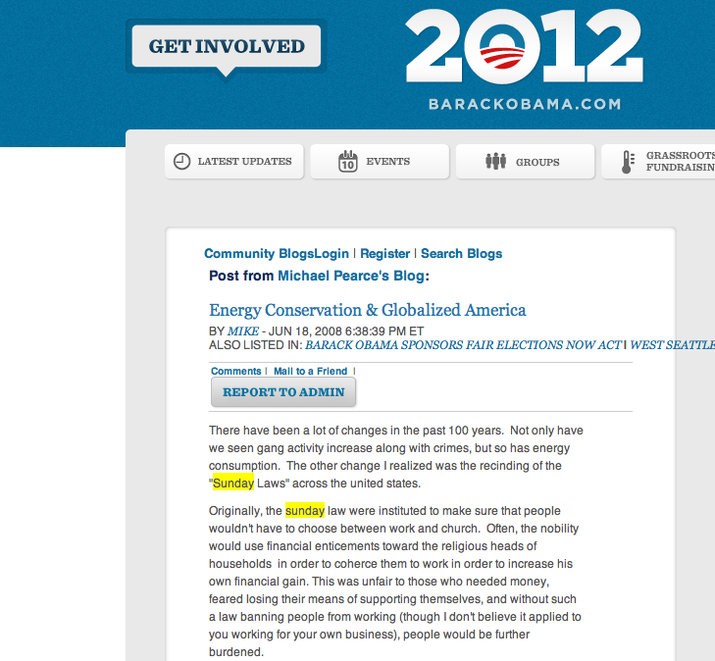

Slide 51
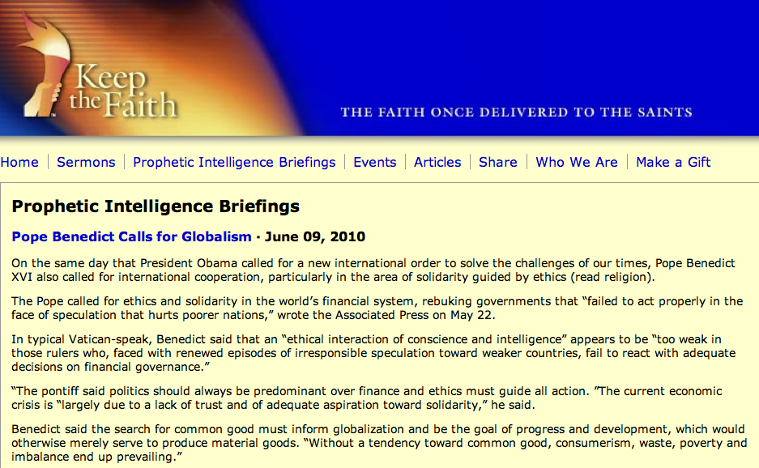
Notes:
Yahoo Link

Slide 55
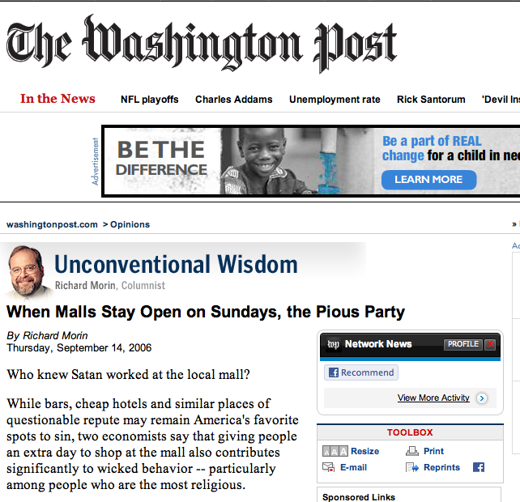
Notes:
http://www.washingtonpost.com/wp-dyn/content/article/2006/09/13/AR2006091301759.html

Slide 56
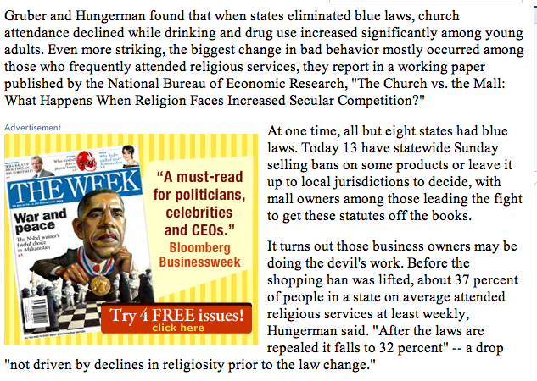

Slide 57
Notes:
http://religion.blogs.cnn.com/2012/01/01/12-faith-based-predictions-for-2012/

Slide 58
Notes:
http://backtochurch.com/

Slide 62
Notes:
http://www.washingtonpost.com/wp-dyn/content/article/2006/09/13/AR2006091301759.html

Slide 64
Notes:
http://www.tencommandmentsday.com/

Slide 65
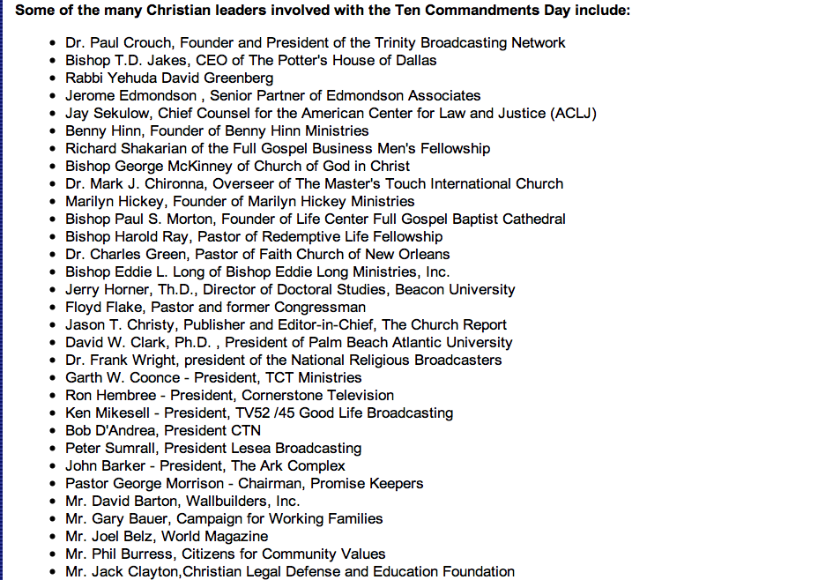

Slide 67
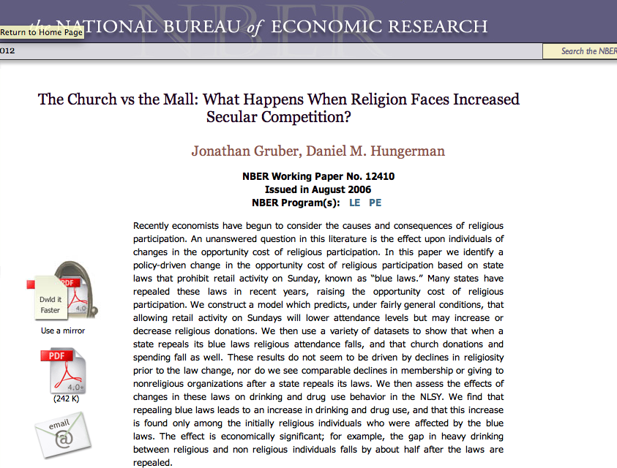
Notes:
http://papers.nber.org/papers/w12410

